Slide 1
Basic Biological Concepts
Gender and Sex Determination
Section 2 – Lecture 5

Slide 2
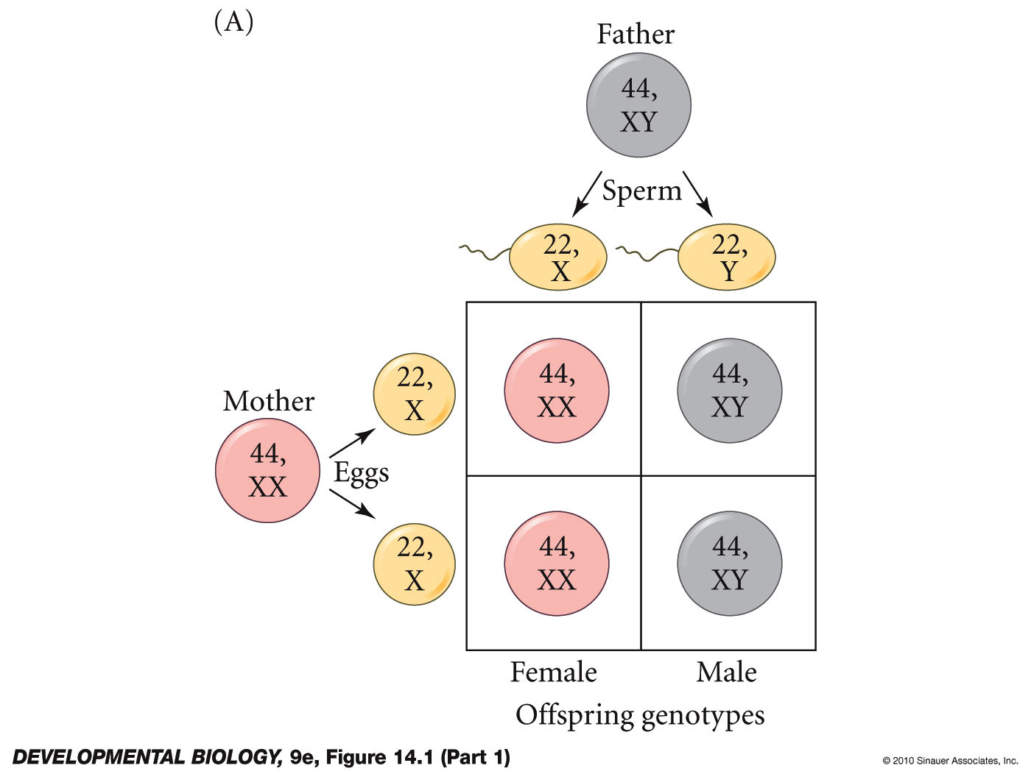
Chromosomal Sex Determination in Humans Comes from the X and Y Chromosomes
Dad is XY and thus half of his gametes deliver X and half deliver Y
Offspring get a 50:50 chance of getting XX or XY
Mom is XX and thus all of her gametes deliver X
Notes:
DevBio9e-Fig-14-01-1R.jpg

Slide 3
The inheritance and cellularity of human sexual reproduction are distinctly binary
We inherit either two X or one X and one Y chromosome
Half of us produce eggs and half produce sperm
One haploid sperm and one haploid egg are required to reproduce diploid offspring

Slide 4
Multiple Binary Strategies in Animalia
Mammals: XX = female, XY = male
Avians: ZZ = male, ZW = female
Flies: 2X = female, 1X = male (Y = no role)
Bees, Ants: 2(n) = female, 1(n) = male

Slide 5
There is a great deal of conflict around sexual orientation and gender identity
A significant portion of our population is attracted to those with the same gear
Others don’t feel that reproduction is the basis for their sexual attraction(s)
Yet others feel as though they are trapped in the wrong physical sex
Still others feel that a binary orientation is ‘good’ and anything else is ‘bad’
What does the biological evidence say?

Slide 6
3-Step Mammalian Sex Determination Timeline
Sex Determination begins in the brain within hours to days
More than 2,000 genes are expressed in gender specific patterns before gonads are up and running
Primary Gonadal Determination by 20 weeks
The arrival of sex cells to gonad brings estradiol or testosterone
Default is female, Y chromosome is crucial for males due to SRY gene
Secondary Sex Determination at puberty
A peak of more than 4,000 genes are expressed in gender specific patterns
Genitalia, ovulation, sperm production, mammaries, size, voice, musculature, hair
Endocrine, paracrine secretions from gonads reach new highs
Absence of gonads produces female phenotype

Slide 7
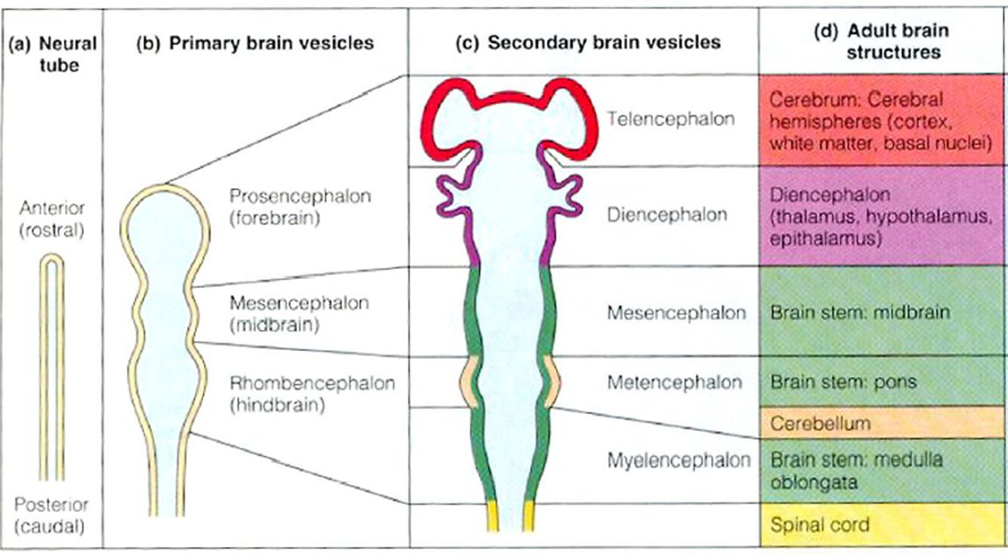
Interestingly, the brain doesn’t wait for the gonads to initiate sex determination like most tissues do
Many genes are expressed in a sexually dimorphic pattern prior to gonad differentiation
These include SRY, which comes from the Y chromosome
Later, gonadal hormones refine an already present “brain sex”

Slide 8
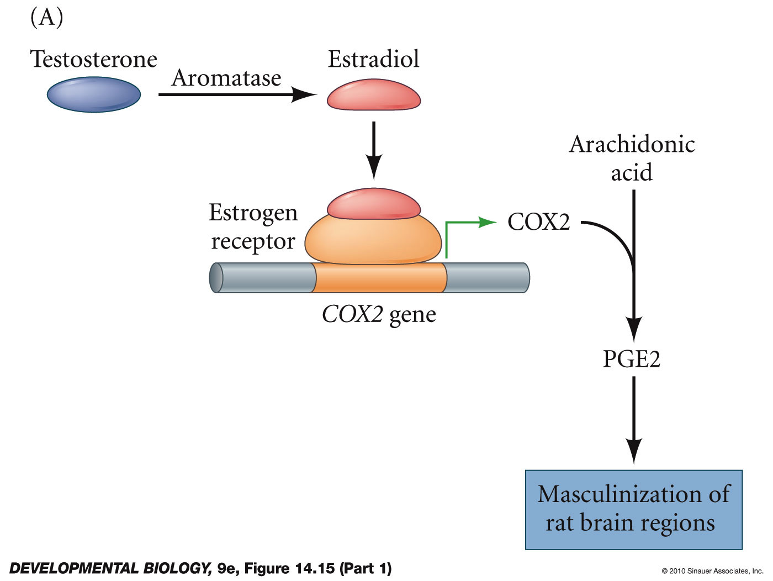
Local testosterone must be converted to
estrogen to masculinize the male brain
(no help from testes at this point!)
Notes:
DevBio9e-Fig-14-15-1R.jpg

Slide 9
Primary Sex Determination in Gonads
First form bipotential “indifferent” primordia
Must wait for arrival of sex cells to determine fate
Default phenotype is female if no testosterone signaling
Y is crucial for SRY gene to initiate “maleness” in gonads

Slide 10
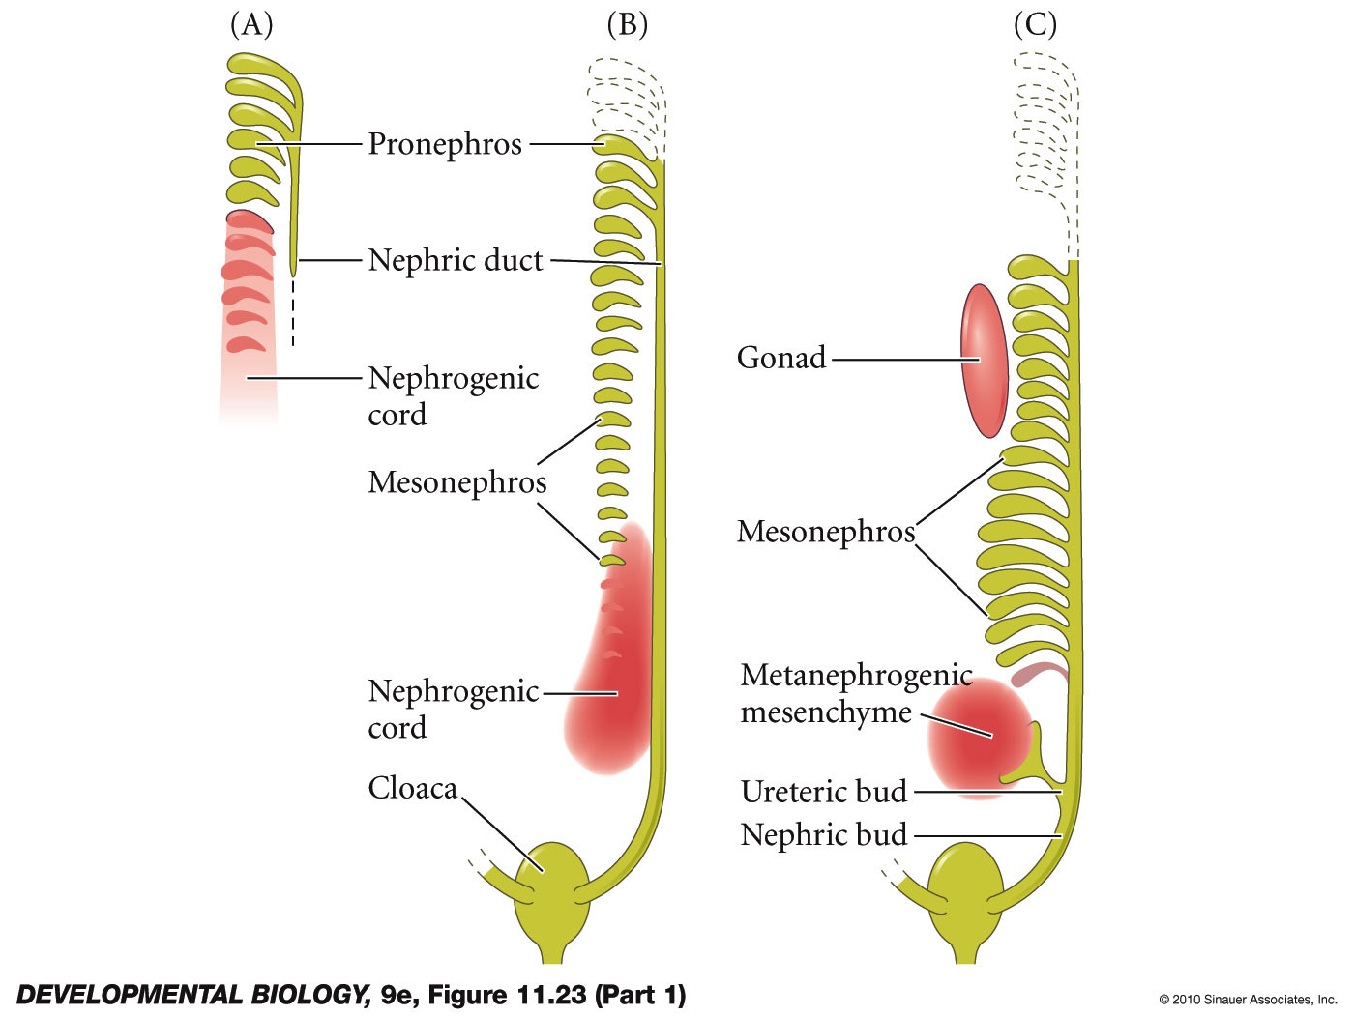
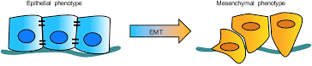
The paired gonads form as the genital ridges right above the developing kidneys at ~ week 4 in humans.
At this stage they are a mixture of two cell types: one epithelial, one mesenchymal.
Notes:
DevBio9e-Fig-11-23-1R.jpg

Slide 11
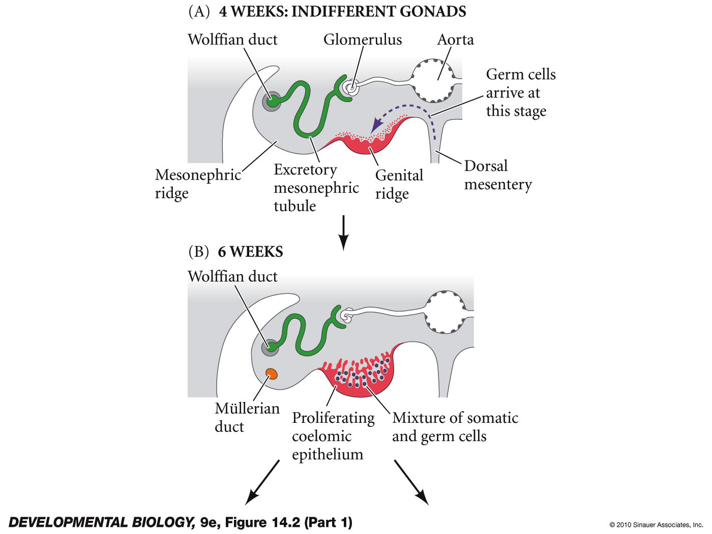
Genital ridge forms as
epithelium mixed with
interstitial mesenchyme
Germline stem cells arrive from elsewhere
Mullerian duct develops parallel to Wolffian duct
Notes:
DevBio9e-Fig-14-02-1R.jpg

Slide 12
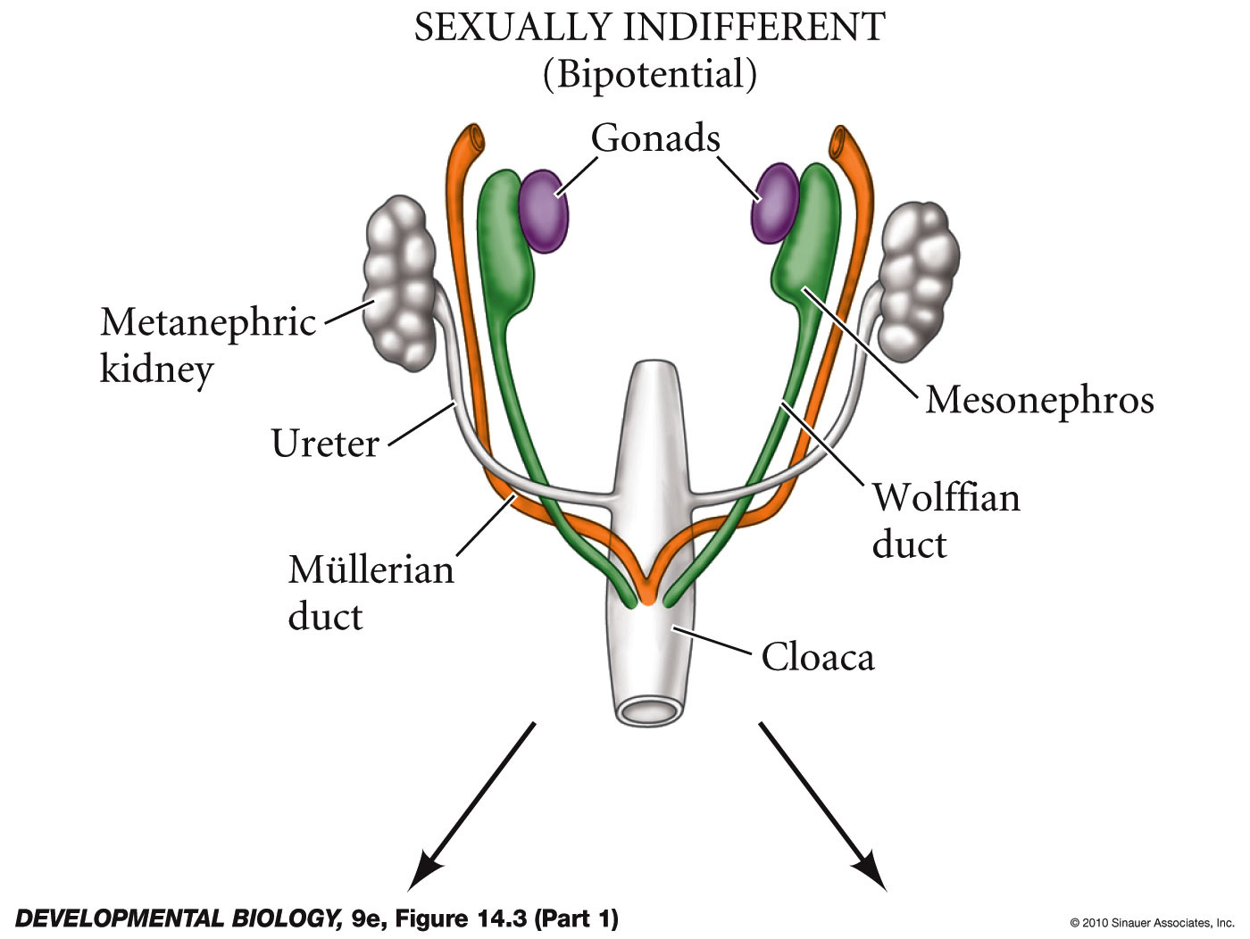
Ultimately forms the Sexually-Indifferent Gonads that are prepped to receive gamete stem cells
Notes:
DevBio9e-Fig-14-03-1R.jpg

Slide 13
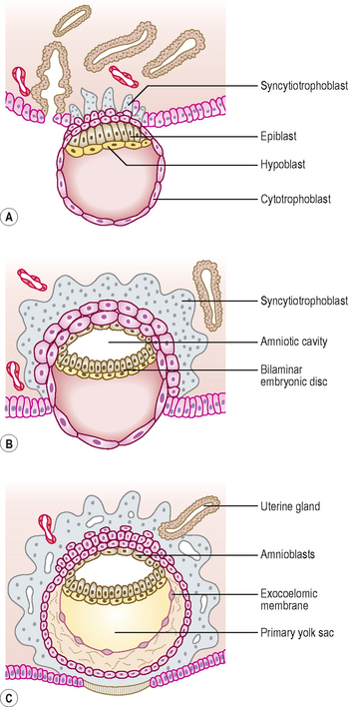
Primordial Germ Cells (PGC) form in the early embryo shortly after implantation
Between 6 and 12 days post-ovulation in humans
PGCs migrate from the hindgut along the gut to reach the gonads in ~4.5 weeks in human beings
10-100 cells @ Day 6.5 in mice
They divide continuously as they migrate and enter the genital ridges as 2500-5000 PGCs by Day 12 in mice.
Notes:
DevBio9e-Fig-08-23-2R.jpg

Slide 14
Remember that only gamete stem cells can perform meiosis
The travelling stem cell niche
Support cells travel with PGCs to maintain the undifferentiated stem cell phenotype
Support cells secrete molecules to accomplish this

Slide 15
What happens to the “indifferent” gonad when the PGCs get there?
Cell Fates determined by 8 weeks
- Epithelium becomes Sertoli cells - Epithelium becomes granulosa cells
- Mesenchyme becomes Leydig cells - Mesenchyme becomes thecal cells
- Germ cells will become spermatogonia - Germ cells become meiotic oogonia
- Together they form the follicles
Ductal fates determined by 16 weeks
- Sertoli AMF degenerates Mullerian duct - No AMF allows devo of Mullerian duct
- Leydig testosterone maintains Wolffian duct - No testosterone degenerates Wolffian duct
- Duct and testis cords become seminiferous - Mullerian = oviduct, uterus, cervix, upper vagina
tubules, vas deferens and epididymous.
Male Female
Notes:
DevBio9e-Fig-14-02-2R.jpg

Slide 16
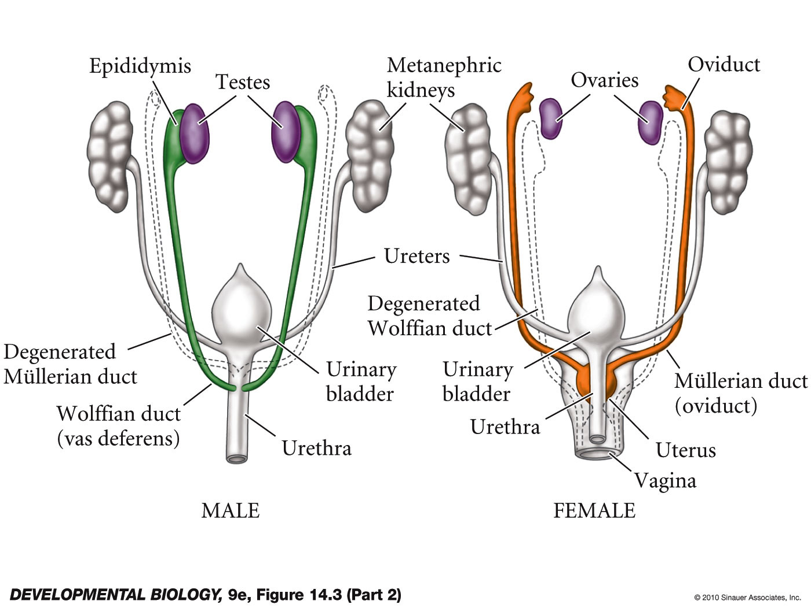
If everything goes well these structures form early and are maintained until puberty fires up their functions
Notes:
DevBio9e-Fig-14-03-2R.jpg

Slide 17
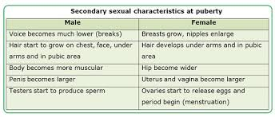
Development of the Secondary Sexual Characteristics
Secondary determination starts at puberty
Secondary characteristics usually match gonadal
The dominant influence is gonadal steroid hormones

Slide 18
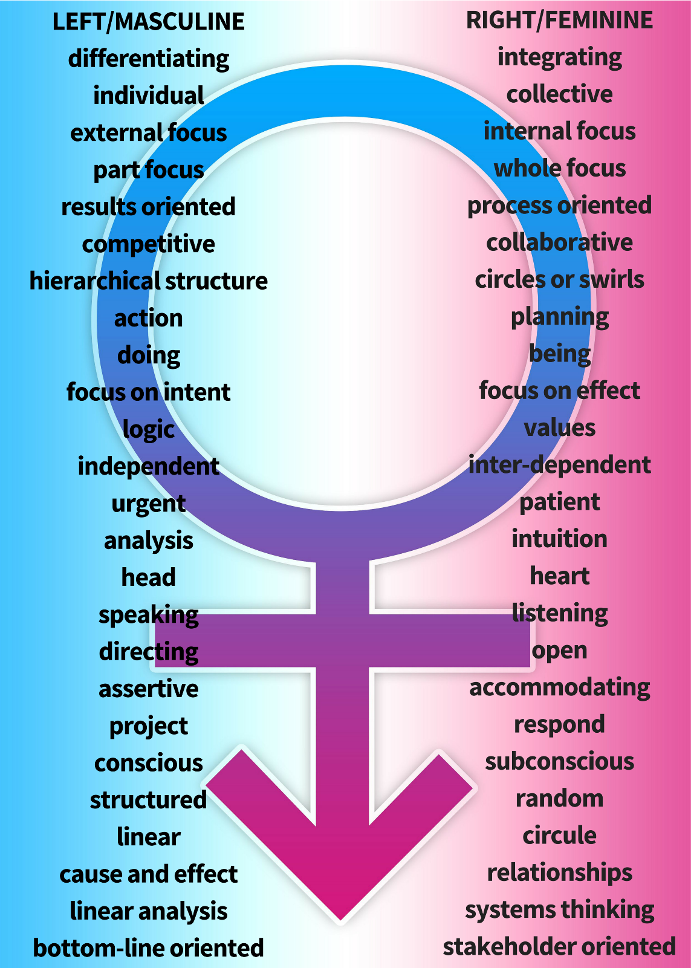
What can we take home from these data?
The default condition at every stage is female
The masculinization vs. feminization of the brain occurs to a large extent prior to gonad and hormone development
Gonadal hormones refine an established brain sex
During gonad development the secretion of hormones determines cellularity and plumbing
During development of secondary characters gonad hormones usually match them to gonad

Slide 19
Two ways that genetic characteristics can vary
Polyphenisms: discontinuous “either-or” phenotypes
The environment selects – usually the most adaptive
Can be two or more discreet choices
These are most often encountered in simpler organisms
Reaction Norms: a continuous range of phenotypes encoded in the genome bounded by an upper and lower limit
The environment selects – usually the most adaptive
These are more commonly encountered in higher organisms
Example: human muscle development depends on exercise

Slide 20
Is the Process 100% Accurate?
Brain sexual dimorphism is a relatively new area of study
Female gene expression is default, masculinization requires local biochemistry
Testosterone production, aromatase expression, estrogen receptors
Gonadal determination can result in female, male, both or none
True hermaphroditism is very rare in humans
Can result from translocation of Y onto X during crossing over
Secondary sex determination starts at puberty
The dominant influence is gonadal steroid hormones
0.4-1.7% of population have mixed traits
This is called pseudohermaphroditism or “Intersex Conditions”

Slide 21
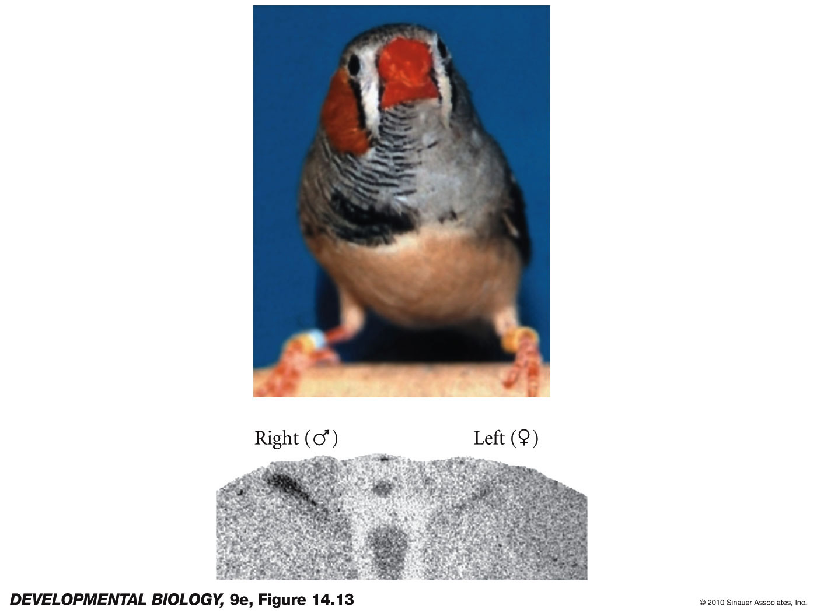
Gynandromorph finch with ZZ (male) cells on its right side and ZW (female) cells on its left side
True
Hermaphrodite
Notes:
DevBio9e-Fig-14-13-0.jpg

Slide 22
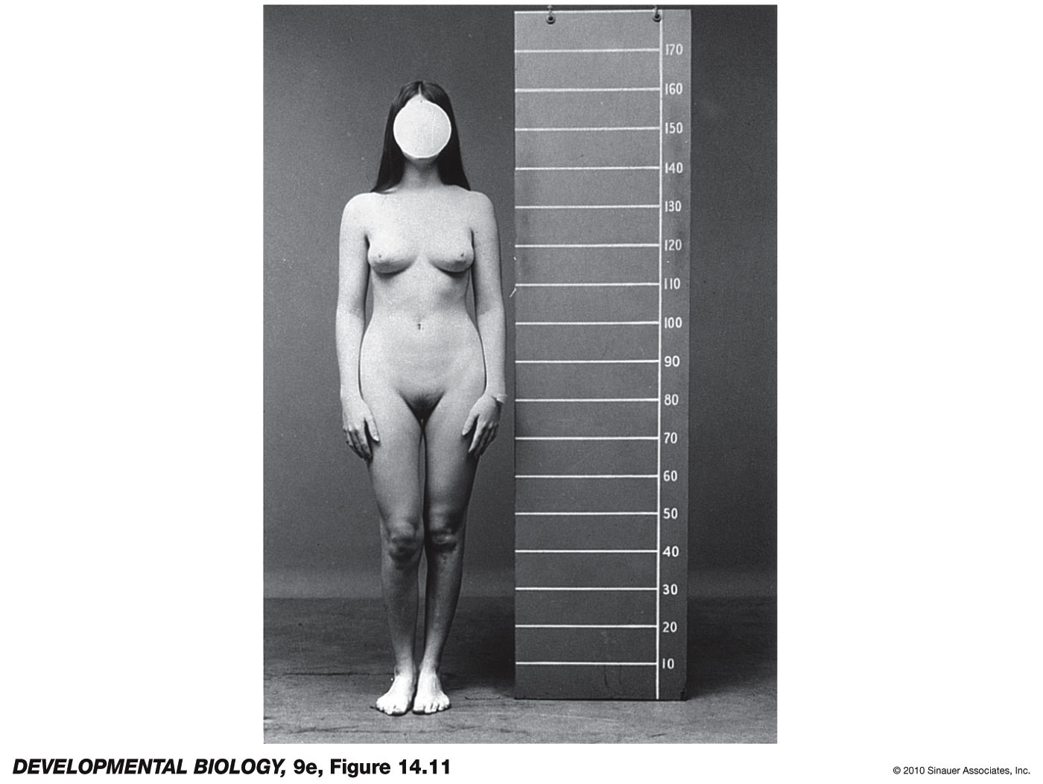
Androgen Insensitivity Syndrome
Gonadal male (XY)
with a mutation
in testosterone
receptors –
estrogen from
adrenal glands
dominates puberty
As estrogen receptors are functional - what do you predict about his/her brain gene expression?
Unfortunately, AMF still causes Mullerian duct degeneration so she is infertile.
Notes:
DevBio9e-Fig-14-11-0.jpg

Slide 23
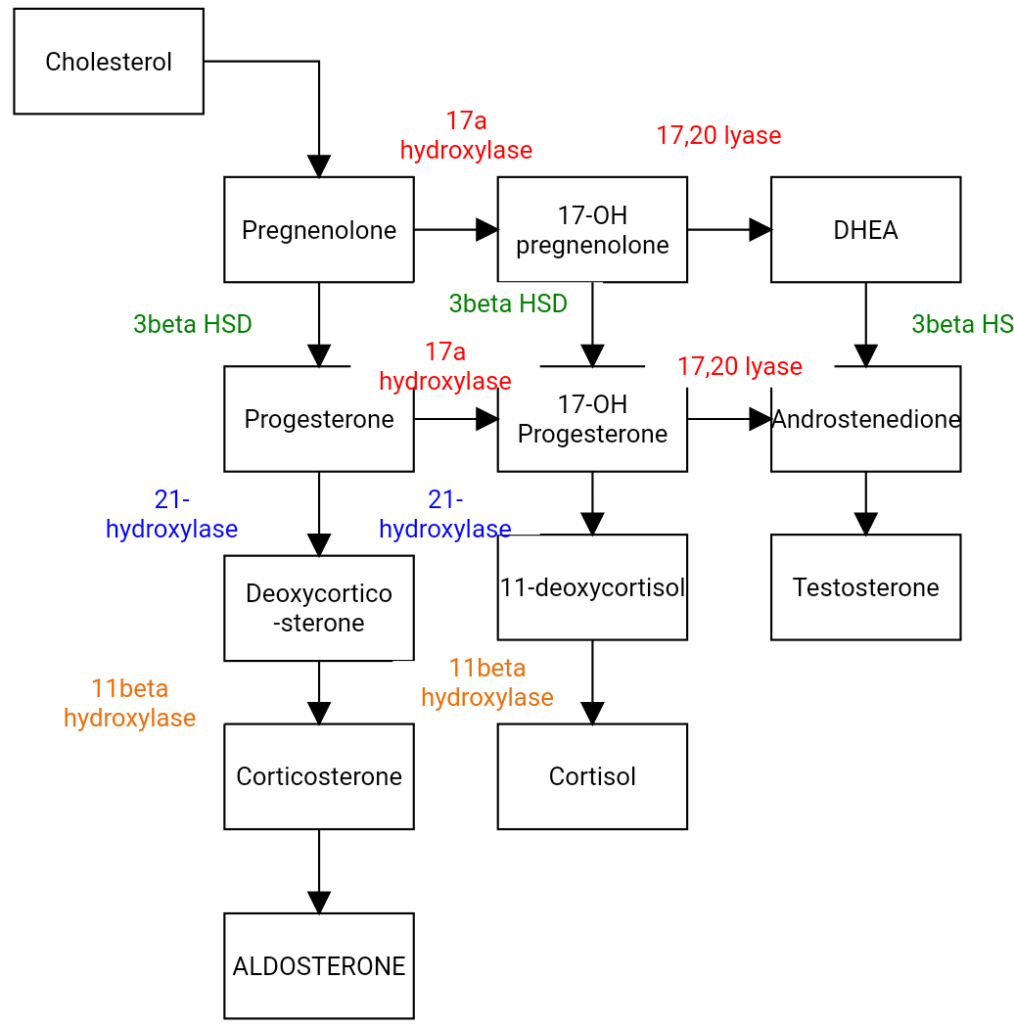
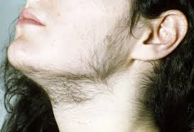
Congenital Adrenal Hyperplasia in Females
Androgens accumulate because of a mutation in the adrenal enzyme to make corticosteroids
Allows male secondary characteristics in a gonadal female

Slide 24
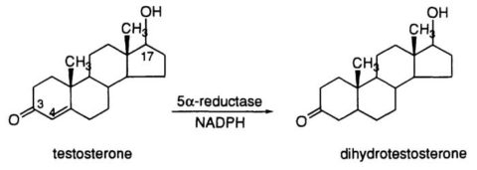
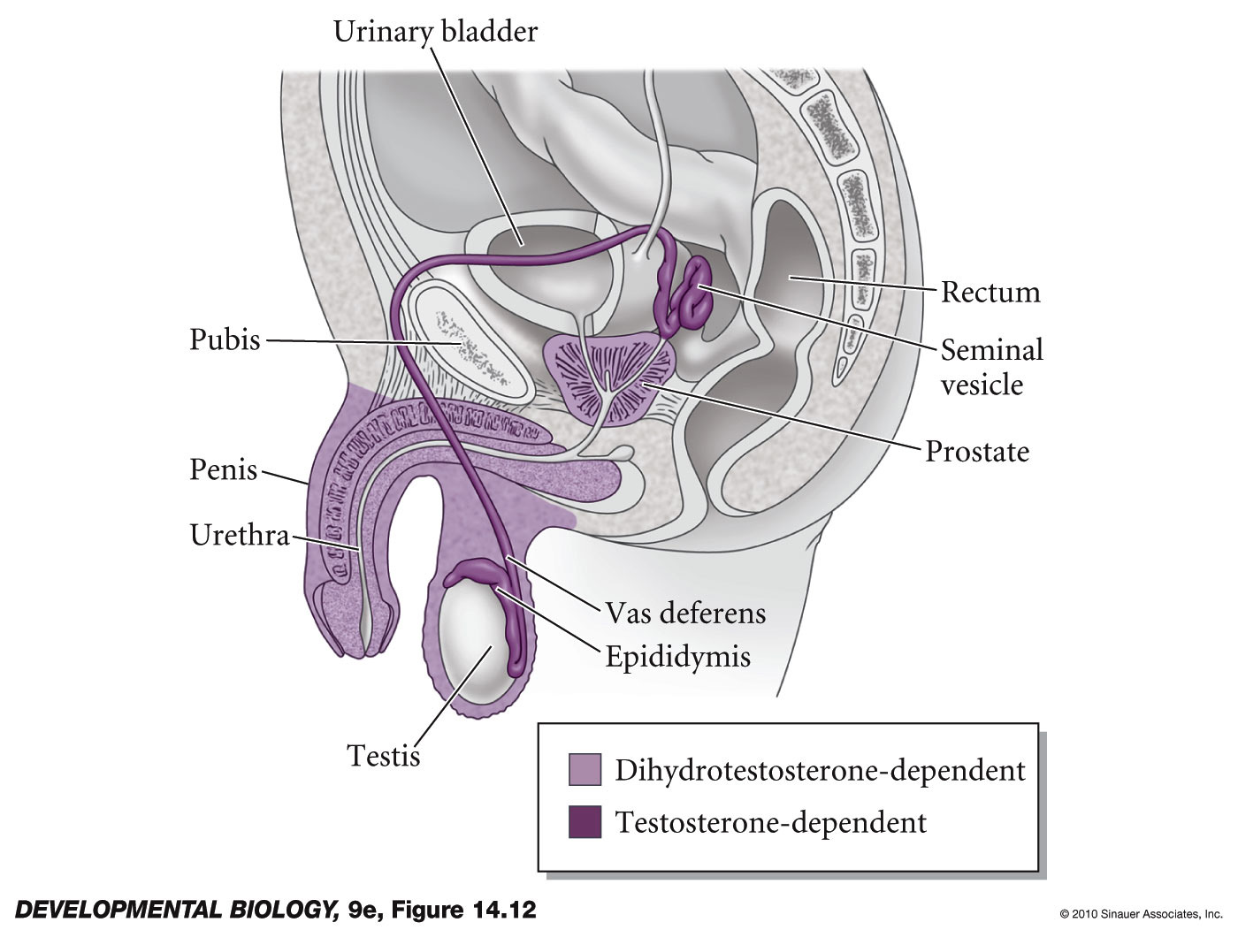
Testosterone must be converted to dihydrotestosterone to finish male system.
Failure to convert causes external genitalia to fail to form prior to puberty
The children are often raised as girls until the high testosterone levels of puberty finish the job!
Notes:
DevBio9e-Fig-14-12-0.jpg

Slide 25
Gender Flexibility is a Surprisingly Common Characteristic in Animalia
Controlling inputs can range across a variety of stimuli:
Environmental changes
Human influences
Population factors within the species
Chance encounters within the species

Slide 26
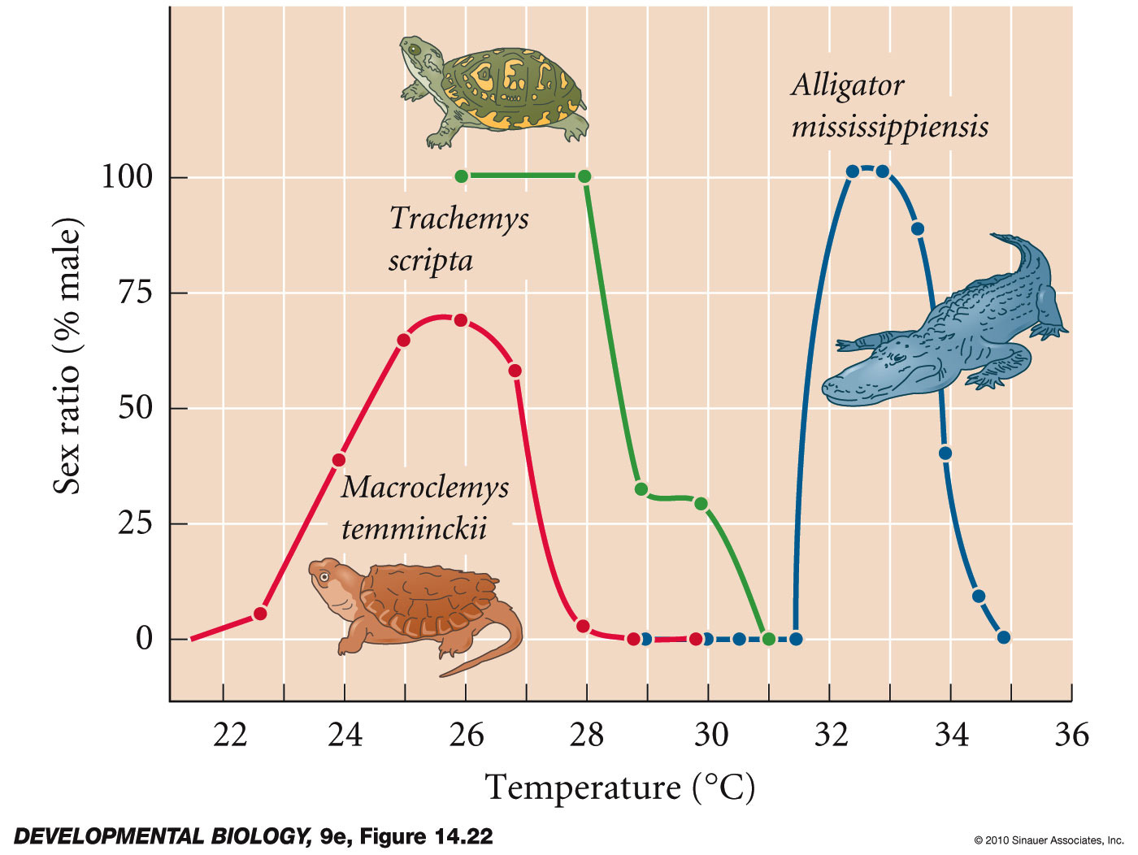
Temperature-dependent sex determination in reptiles: American alligator, red-eared slider turtle, and alligator snapping turtle
The ratio of males to females varies with the average ambient temperature
Notes:
DevBio9e-Fig-14-22-0.jpg

Slide 27
Increased environmental estrogenic compounds
At elevated levels, the percentage of reptile and amphibian males crashes
Has wide-ranging effects on human development
We put three key things into environment
Estrogen/Progesterone birth control
Estrogenic plasticizers
Surprise estrogenics: Methyl-Hg, Cadmium, etc.

Slide 28
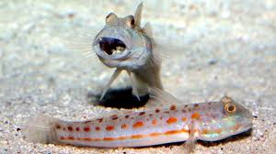
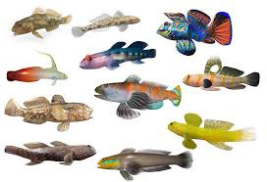
Population conditions in Goby fish
School is one male, many females
If male is lost, top females race to change
Most aggressive becomes dominant male

Slide 29
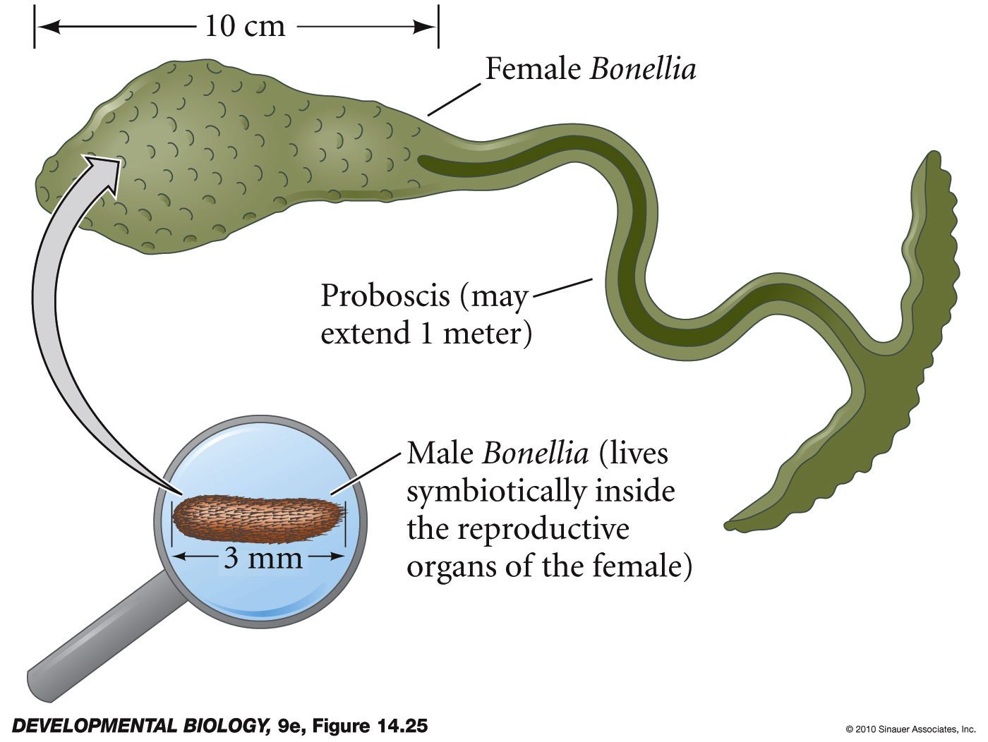
Chance encounters in Bonellia
Larva drops to sea floor - female
Larva finds proboscis of adult female – male
Notes:
DevBio9e-Fig-14-25-0.jpg

